Slide 2
Overview
Keel Cooling Technology
Materials
Design Features
Installation
Recommendation Form
Competitors

Slide 3
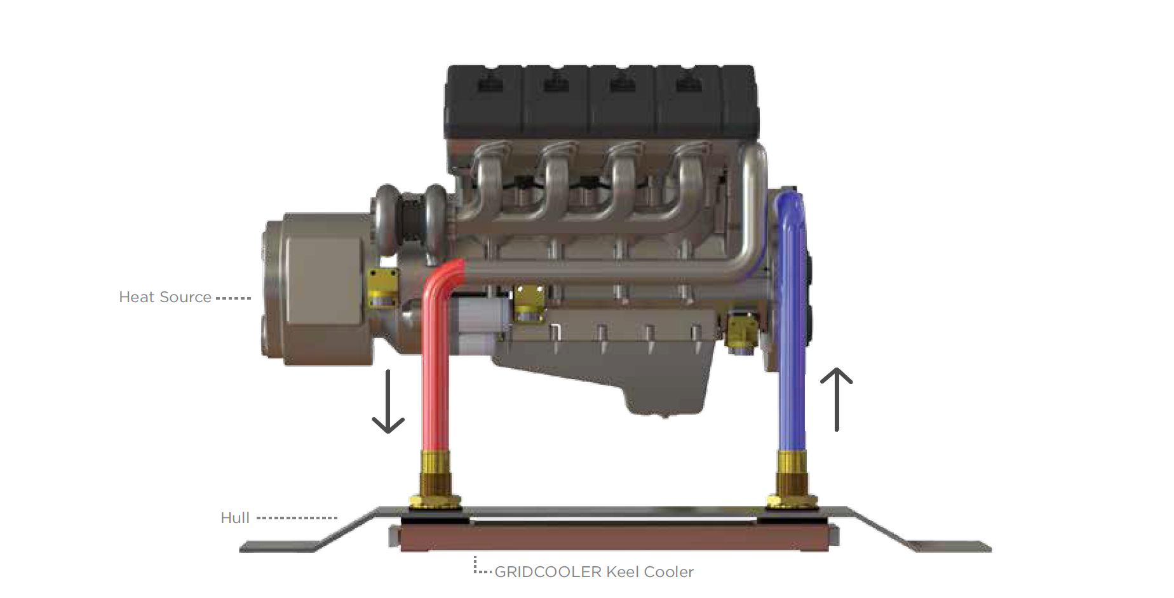
Keel Cooling

Slide 4
Engineered to Cool

Slide 5
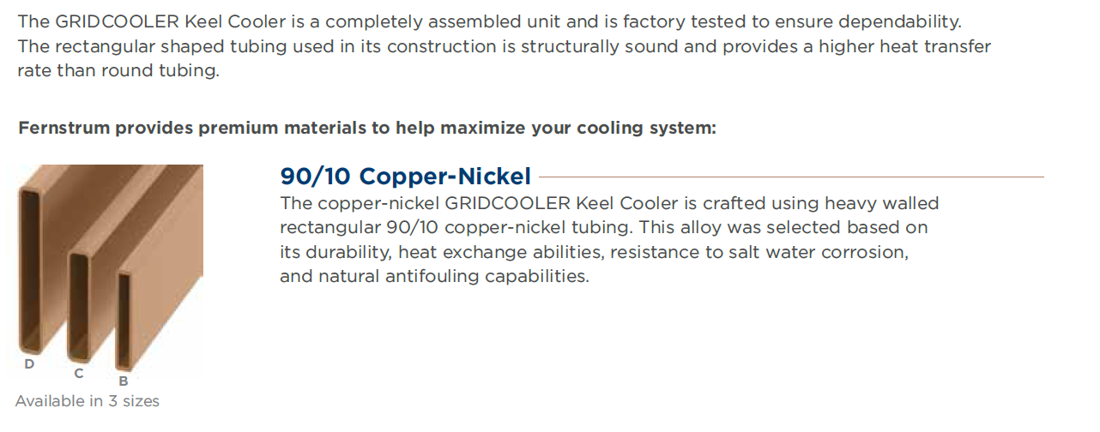
Materials

Slide 6
Materials

Slide 7
Design Flexibility

Slide 8
Design Flexibility

Slide 9
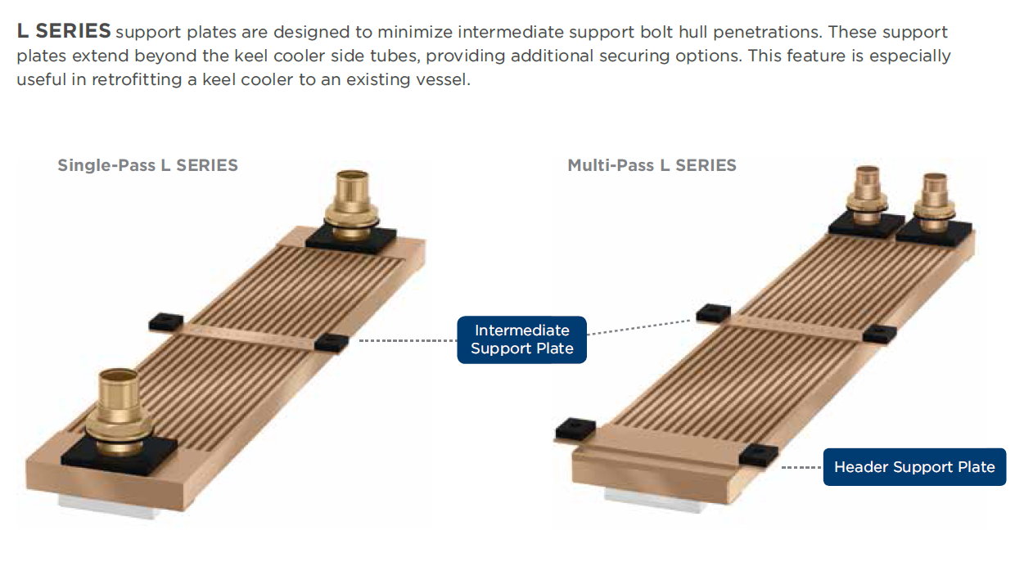
Design Flexibility

Slide 10
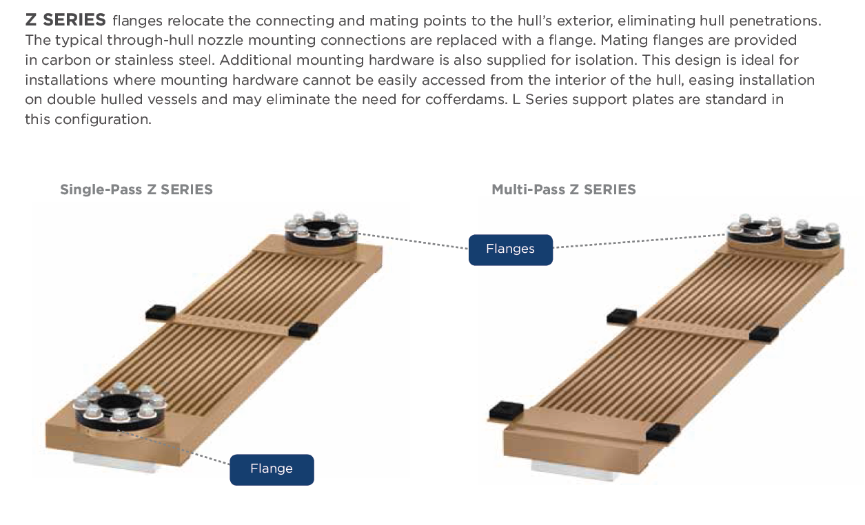
Design Flexibility

Slide 11
Design Flexibility

Slide 12
Design Flexibility

Slide 13
Design Flexibility

Slide 14
Installation

Slide 15
Installation

Slide 16
Installation

Slide 17
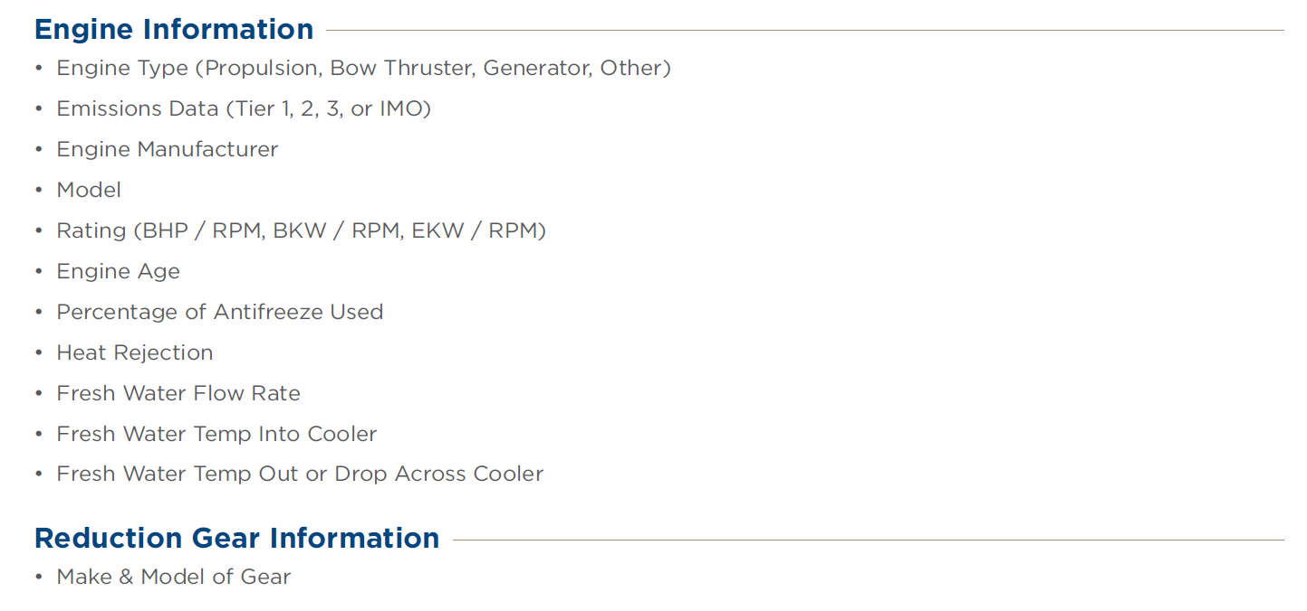
Recommendation Information

Slide 18
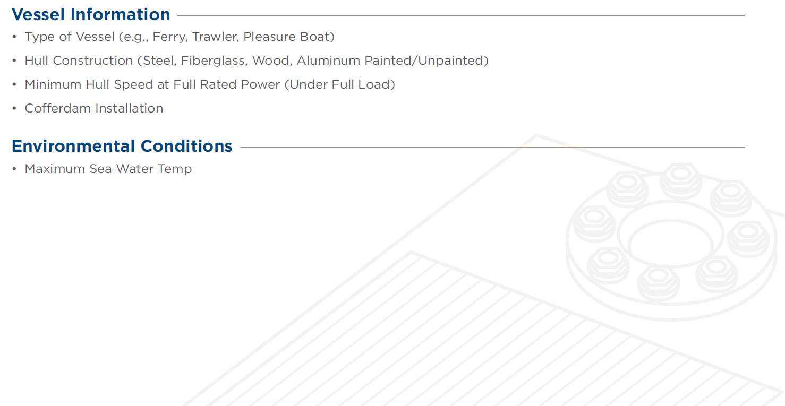
Recommendation Information

Slide 19
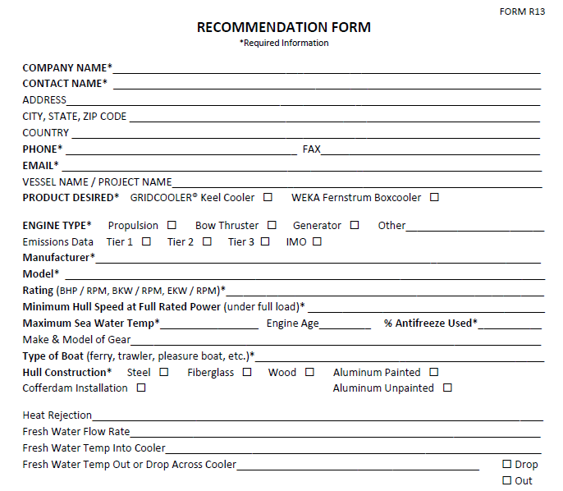

Slide 20
Competitors
Duramax Marine
East Park Radiator & Battery Shop, Inc
The Walter Machine Co., Inc
Channel Cooling

Slide 21
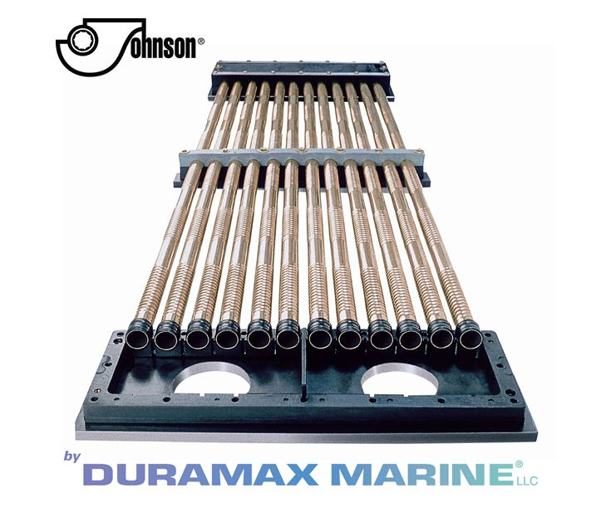
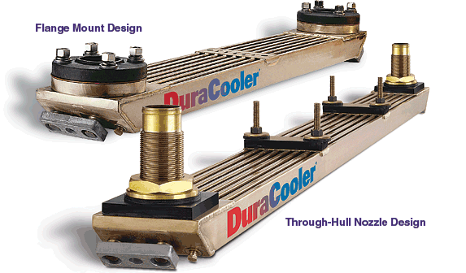
Duramax Marine
DuraCooler Keel Cooler
Demountable Keel Cooler
Images courtesy of duramaxmarine.com

Slide 22
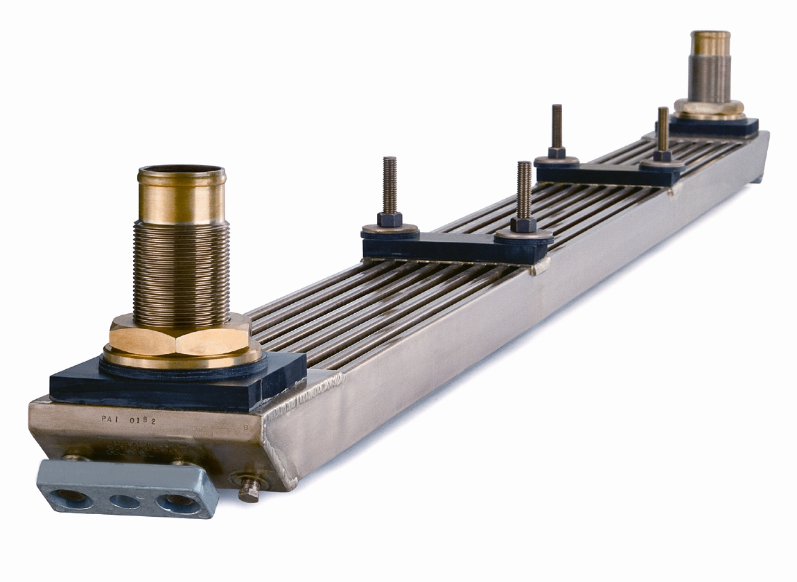
East Park Radiator & Battery Shop, Inc
Duraweld Keel Cooler
Image courtesy of eastparkrad.com

Slide 23
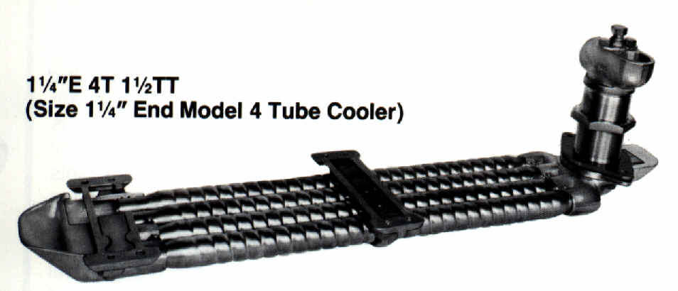
The Walter Machine Co., Inc
Walter Keel Coolers
Turbo Tube
Image courtesy of Waltergear.com

Slide 24
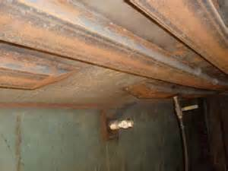
Channel Cooling

Slide 25
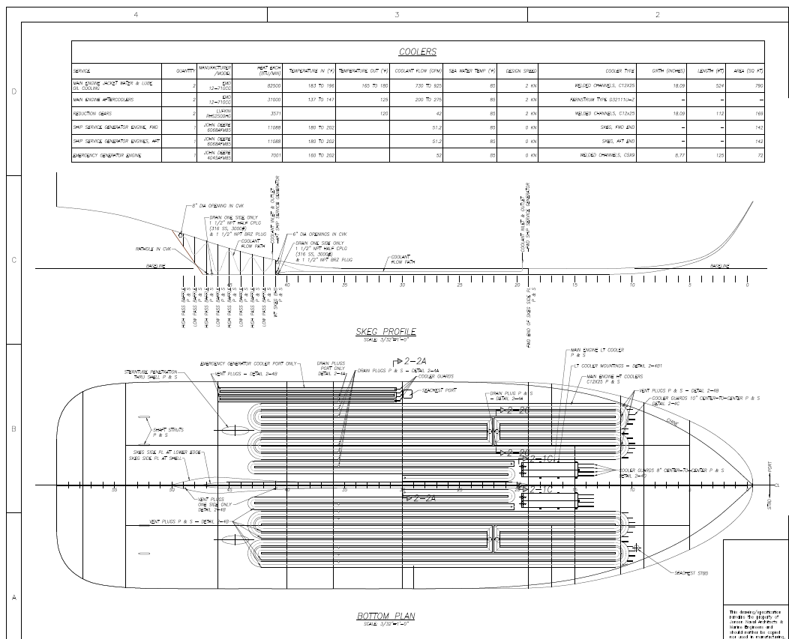
Channel Cooling

Slide 26
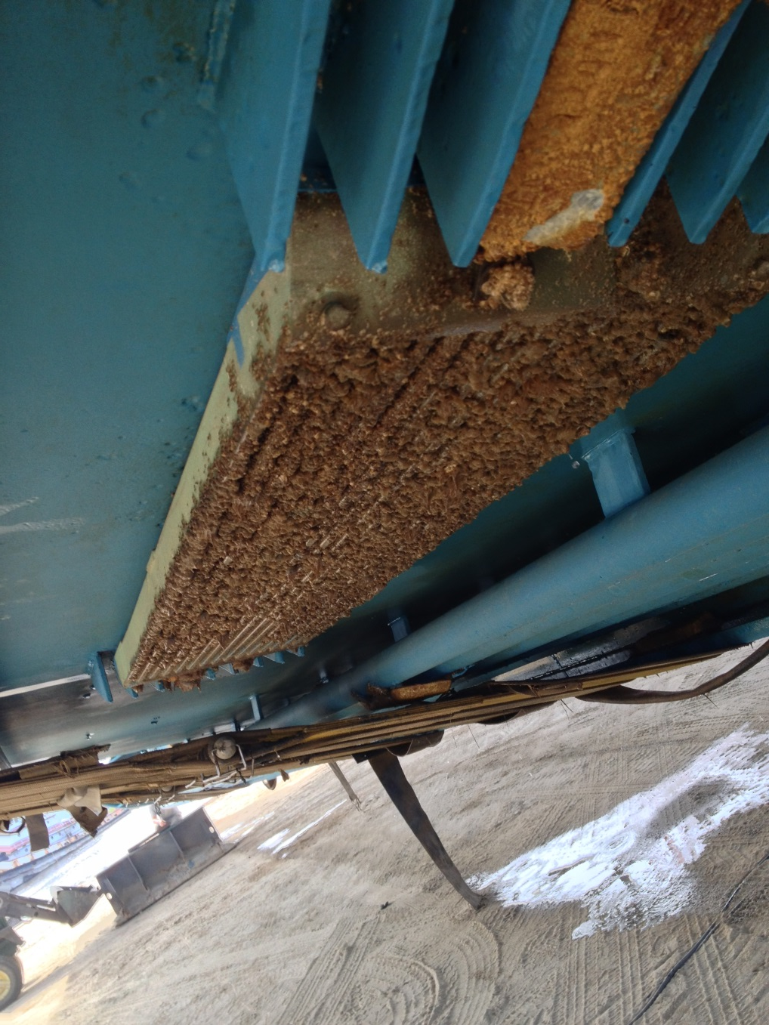
Marine Growth

Slide 27
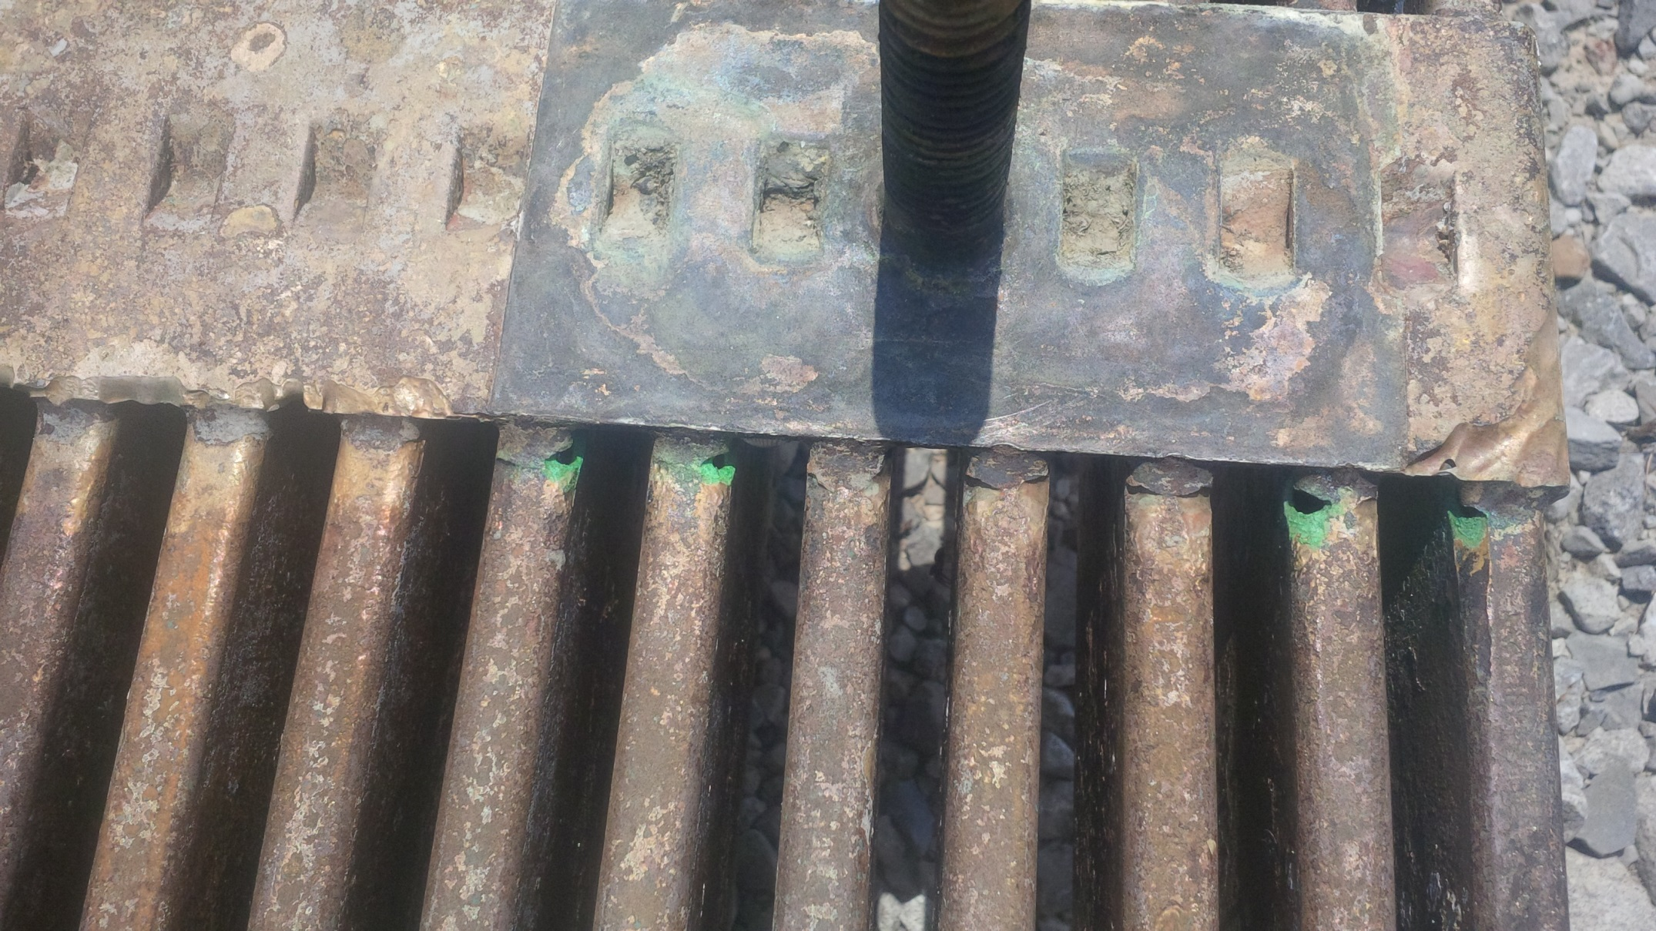
Stray Electrical Currents

Slide 28
Questions?

